Slide 1


Programming with C++
Chapter 5: Arrays & Strings
Bujar Mamudi
Yahya Kemal College
Fall 2012

Slide 2
Contents:
Functions (review)
Header Files
Static Arrays & Vector Class
Vector Manipulation
Multidimensional Arrays
Arrays as Parameters
Searching Arrays
Sorting Arrays
String Class
Measuring run time

Slide 3


Functions

Slide 4
Understanding Functions
A function is a group of instructions that performs a specific task, and executed when it is called from any point of the program code.
So far we have worked only with the main() function.

Slide 5
Advantages of using functions
Functions promote code-reuse.
the same function can be used over and over again.
Functions promote simpler code.
the functionality is divided ( and conquered), and most of it is written outside the function main().
Functions promote more readable code.
using appropriate names which describe what the function does, makes life easier for everyone.

Slide 6
Implementing functions. (First way: call + definition)
#include<iostream>
using namespace std;
//function definition
type functionName(type parameter, ... ,type parameter)
{
// function code
}
int main()
{
//function call
functionName(type parameter, ... ,type parameter);
}

Slide 7

//DESCRIPTION: function to show hello world
#include<iostream>
using namespace std;
//function defintion
void showHelloWorld()
{
cout<<"Hello World!\n\n";
}
int main()
{
//function call
showHelloWorld();
}

Slide 8
Implementing functions. (Second way: prototype + call + definition)
#include<iostream>
using namespace std;
//function prototype
type functionName(type , ... ,type );
int main()
{
//function call
functionName(type parameter, ... ,type parameter);
}
//function definition
type functionName(type parameter, ... ,type parameter)
{
// function code
}

Slide 9
//DESCRIPTION: function to show hello world
#include<iostream>
using namespace std;
//function prototype
void showHelloWorld();
int main()
{
//function call
showHelloWorld();
}
//function defintion
void showHelloWorld()
{
cout<<"Hello World!\n\n";
}

Slide 10
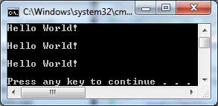
//DESCRIPTION: function called three times
#include<iostream>
using namespace std;
//function defintion
void showHelloWorld()
{
cout<<"Hello World!\n\n";
}
int main()
{
//function called three times
showHelloWorld();
showHelloWorld();
showHelloWorld();
}

Slide 11
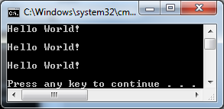
//DESCRIPTION: function called three times
#include<iostream>
using namespace std;
//function prototype
void showHelloWorld();
int main()
{
//function called three times
showHelloWorld();
showHelloWorld();
showHelloWorld();
}
//function defintion
void showHelloWorld()
{
cout<<"Hello World!\n\n";
}

Slide 12
Find sum, difference, product, quotient
Write a C++ program that uses functions to find the sum, difference, product, and quotient of two numbers.

Slide 13
//DESCRIPTION: find sum, difference, product, quotient
#include<iostream>
using namespace std;
//function prototypes
int getSum(int,int);
int getDiff(int,int);
int getProd(int,int);
int getQuot(int,int);
float getQuotient(int,int);
void showResult(int,int,int,int,float);
int main()
{
int a=5, b=3; //global variable declaration
int s, d, p, q; //variables to store the results
float fq;
//function call;
s = getSum(a,b);
d = getDiff(a,b);
p = getProd(a,b);
q = getQuot(a,b);
fq = getQuotient(a,b);
showResult(s,d,p,q,fq);
return 0;
}

Slide 14
//function definitions
int getSum(int x,int y)
{
//local variable declaration
int sum;
sum = x + y;
return sum;
}
int getDiff(int i,int j)
{
return i-j;
}
int getProd(int a,int b)
{
return a*b;
}
int getQuot(int c ,int d)
{
return c/d;
}

Slide 15
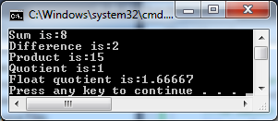
float getQuotient(int a,int b)
{
return (float)(a)/b;
}
void showResult(int a,int b,int c,int d, float e)
{
cout<<"Sum is:"<<a <<endl;
cout<<"Difference is:"<<b <<endl;
cout<<"Product is:"<<c <<endl;
cout<<"Quotient is:"<<d <<endl;
cout<<"Float quotient is:"<<e <<endl;
}

Slide 16
Passing arguments to functions

Slide 17
Pass by value VS. Pass by reference
Pass by value creates a copy of the variables it takes as arguments. The changes it makes are done with those copies only.
The changes are not saved!

Slide 18

#include<iostream>
using namespace std;
//function definition
void increment(int a,int b)
{
a++;
b++;
cout<<"Hello from increment function: "<<a<<" "<<b<<endl;
}
int main()
{
int a=5, b=3;
//function call
increment(a,b);
cout<<"Hello from main function: "<<a<<" "<<b<<endl;
}

Slide 19
Pass by value VS. Pass by reference
Pass by reference passes the actual memory address as an argument instead of creating a copy. The changes will be saved!
You must add the address operator (&) in front of the variable before the function prototype and function definition.

Slide 20

#include<iostream>
using namespace std;
//function definition
void increment(int &a,int &b)
{
a++;
b++;
cout<<"Hello from increment function: "<<a<<" "<<b<<endl;
}
int main()
{
int a=5, b=3;
//function call
increment(a,b);
cout<<"Hello from main function: "<<a<<" "<<b<<endl;
}

Slide 21
#include<iostream>
using namespace std;
//function prototype
void increment(int &,int &);
int main()
{
int a=5, b=3;
//function call
increment(a,b);
cout<<"Hello from main function: "<<a<<" "<<b<<endl;
}
//function definition
void increment(int &a,int &b)
{
a++;
b++;
cout<<"Hello from increment function: "<<a<<" "<<b<<endl;
}

Slide 22
Functions
In the programming competition, for the beginner level, functions are not the main focus.
If you don’t feel comfortable with them yet, don’t worry about it, simply don’t use them.

Slide 23
Header Files

Slide 24
Working with multiple files
As programs get larger, it is not uncommon to split them into multiple files for organizational purposes.
One disadvantage: writing function prototypes over and over again.

Slide 25
// File: Code.cpp
#include <iostream>
using namespace std;
int doSmth(int, int);
int main()
{
cout << "4 smth 5 is: " << doSmth(4, 5) << endl;
int doSmthElse(int, int);
cout << "4 smth else 5 is: " << doSmthElse(4, 5) << endl;
return 0;
}

Slide 26
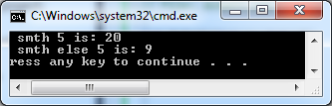
// File: doSmth.cpp
int doSmth(int x, int y)
{
return x*y;
}
int doSmthElse(int x, int y)
{
return x+y;
}

Slide 27
Header files
The purpose of a header file is to hold declarations for other files to use.
Make sure you define the header guard
#ifndef NAME_H
#define NAME_H
// function prototype
#endif

Slide 28
// File: doSmth.h
#ifndef DOSMTH_H
#define DOSMTH_H
int doSmth(int x, int y); // function prototype
int doSmthElse(int x, int y); // function prototype
#endif

Slide 29
// File: Code.cpp
#include <iostream>
#include "doSmth.h"
using namespace std;
//int doSmth(int, int);
int main()
{
cout << "4 smth 5 is: " << doSmth(4, 5) << endl;
//int doSmthElse(int, int);
cout << "4 smth else 5 is: " << doSmthElse(4, 5) << endl;
return 0;
}

Slide 30
// File: doSmth.cpp
int doSmth(int x, int y)
{
return x*y;
}
int doSmthElse(int x, int y)
{
return x+y;
}

Slide 31
Arrays

Slide 32
Understanding Arrays
So far we have used variables that can hold only one value at a time.
However we often encounter problems that need to manipulate a series of data.
For such cases we need a data structure that is capable to store a series of variables that are of the same type.

Slide 33
Types of Arrays
An array is a simple data structure that allows us to declare and use a series of same type of data.
C++ supports two types of arrays:
Static arrays – have a fixed constant size
int myStaticArray[10];
Dynamic arrays – can be resized ( must include the vector library )
#include<vector>
using namespace std;
int main()
{
vector<int> myDynamicArray;
myDynamicArray.resize(5);
}

Slide 34
Static Arrays

Slide 35
Static Arrays
type arrayName[elements];
For static arrays, the number of elements must be a constant value, example
int arrayOne[1];
float arrayTwo[20];
char arrayTen[5];
You can not declare an array with a variable as the number of elements:
int wrongArray[n];

Slide 36
Initializing Static Arrays
You can initialize static arrays in two ways:
//specifying the number of elements
int myArray[5] = { 16, 2, 77, 40, 12071 };
//without specifying the number of elements
int myArray[] = { 16, 2, 77, 40, 12071 };

Slide 37

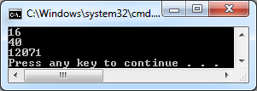
Access elements of Static Arrays
To access the array elements, use the appropriate index which start from 0 for the first element and elements-1 for the last element.
Example:
int myArray[5] = { 16, 2, 77, 40, 12071 };
cout<<myArray[0]<<endl;
cout<<myArray[3]<<endl;
cout<<myArray[4]<<endl;

Slide 38
Operations with Static Arrays
int myArray[5] = { 16, 2, 77, 40, 12071 };
We can change the values of an array element:
//change second element
myArray[1] = 44;
We can assign array elements to other variables:
//assign last element to a variable
int num1;
num1 = myArray[4];

Slide 39

Transverse static array elements
int myArray[5] = { 16, 2, 77, 40, 12071 };
We can use loops to transverse array elements:
for(int i=0; i<5; i++)
{
//show element with index i
cout<<myArray[i]<<" ";
}

Slide 40

Transverse static array elements
int myArray[5] = { 16, 2, 77, 40, 12071 };
We can use loops to transverse array elements:
int sum=0;
for(int i=0; i<5; i++)
{
//find sum of array elements
sum += myArray[i];
}
cout<<"sum of elements of array = "<<sum<<endl;

Slide 41
Class average
Write a C++ program that helps a teacher finds the average of student marks.

Slide 42
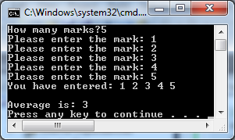
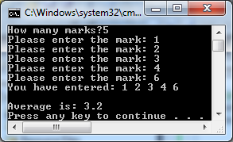
#include<iostream>
using namespace std;
int main()
{
int studentNum, sum=0;
float average;
// a static arrays with more elements that a teacher can ever imagine too use
int marksArray[100000];
cout<<"How many marks?"; //get student num
cin>>studentNum;
for(int i=0; i<studentNum; i++) //save the marks in the array
{
cout<<"Please enter the mark: ";
cin>>marksArray[i];
}
cout<<"You have entered: "; //show the marks entered by teacher
for(int i=0; i<studentNum; i++)
{
cout<<marksArray[i]<<" ";
}
for(int i=0; i<studentNum; i++) //get the sum of marks
{
sum += marksArray[i];
}
average = (float)(sum) / studentNum; //calculate and show average
cout<<"\n\nAverage is: "<< average <<endl;
return 0;
}

Slide 43
Multidimensional Static Arrays

Slide 44

Multidimensional Static Arrays
Arrays can have more than one dimension:
//two dimensional array with 3 rows and 5 columns
int myArray[3][5];
//three dimensional array with three coordinates
int myArray[4][3][5];

Slide 45
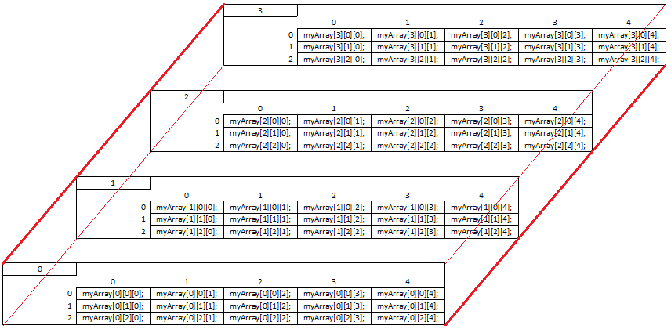
//three dimensional array with three coordinates
int myArray[4][3][5];

Slide 46
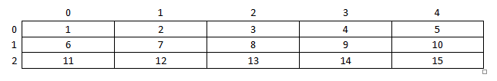
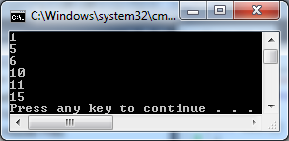
Initializing two-dimensional arrays
You can initialize the values of an array:
//get values by coordinates Array[0][0], Array[0][1]… Array[2][4]
int myArray[3][5]= { 1,2,3,4,5,6,7,8,9,10,11,12,13,14,15 };
cout<< myArray[0][0] <<endl;
cout<< myArray[0][4] <<endl;
cout<< myArray[1][0] <<endl;
cout<< myArray[1][4] <<endl;
cout<< myArray[2][0] <<endl;
cout<< myArray[2][4] <<endl;

Slide 47
Initializing two-dimensional arrays
You can order the values with braces:
//order them with braces row by row, from left to right
int myArray[3][5]= { { 1,2,3,4,5}, { 6,7,8,9,10}, { 11,12,13,14,15} };
cout<< myArray[0][0] <<endl;
cout<< myArray[0][4] <<endl;
cout<< myArray[1][0] <<endl;
cout<< myArray[1][4] <<endl;
cout<< myArray[2][0] <<endl;
cout<< myArray[2][4] <<endl;

Slide 48
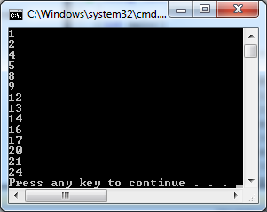
Initializing three-dimensional arrays
You can initialize the values of an array:
//get Array[0][0][0], Array[0][0][1]… Array[1][2][3]
int myArray[2][3][4] = { 1, 2, 3, 4, 5, 6, 7, 8, 9, 10, 11, 12, 13, 14, 15, 16, 17, 18, 19, 20, 21, 22, 23, 24 };
cout<< myArray[0][0][0] <<endl;
cout<< myArray[0][0][1] <<endl;
cout<< myArray[0][0][3] <<endl;
cout<< myArray[0][1][0] <<endl;
cout<< myArray[0][1][3] <<endl;
cout<< myArray[0][2][0] <<endl;
cout<< myArray[0][2][3] <<endl;
cout<< myArray[1][0][0] <<endl;
cout<< myArray[1][0][1] <<endl;
cout<< myArray[1][0][3] <<endl;
cout<< myArray[1][1][0] <<endl;
cout<< myArray[1][1][3] <<endl;
cout<< myArray[1][2][0] <<endl;
cout<< myArray[1][2][3] <<endl;

Slide 49
Initializing three-dimensional arrays
You can order them with braces:
//order them with braces in 2 groups, of 3 rows and 4 column elements
int myArray[2][3][4] = {
{{1, 2, 3, 4}, {5, 6, 7, 8}, {9, 10, 11, 12}},
{{13, 14, 15, 16}, {17, 18, 19, 20}, {21, 22, 23, 24}}
};
cout<< myArray[0][0][0] <<endl;
cout<< myArray[0][0][1] <<endl;
cout<< myArray[0][0][3] <<endl;
cout<< myArray[0][1][0] <<endl;
cout<< myArray[0][1][3] <<endl;
cout<< myArray[0][2][0] <<endl;
cout<< myArray[0][2][3] <<endl;
cout<< myArray[1][0][0] <<endl;
cout<< myArray[1][0][1] <<endl;
cout<< myArray[1][0][3] <<endl;
cout<< myArray[1][1][0] <<endl;
cout<< myArray[1][1][3] <<endl;
cout<< myArray[1][2][0] <<endl;
cout<< myArray[1][2][3] <<endl;

Slide 50
Operations with Static Multidimensional Arrays
int myArray[3][5]= { { 1,2,3,4,5}, { 6,7,8,9,10}, { 11,12,13,14,15} };
We can change the values of an array element:
//change second element
myArray[0][1] = 44;
We can assign array elements to other variables:
//assign last element to a variable
int num1;
num1 = myArray[2][4];

Slide 51
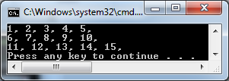
Transverse static two-dimensional array elements
int myArray[3][5]= { { 1,2,3,4,5}, { 6,7,8,9,10}, { 11,12,13,14,15} };
We can use loops to transverse array elements:
for(int i=0; i<3; i++)
{
for(int j=0; j<5; j++)
{
//show element with index i and j
cout<<myArray[i][j]<<", ";
}
//move to next row
cout<<"\n";
}

Slide 52

Transverse static two-dimensional array elements
int myArray[3][5]= { { 1,2,3,4,5}, { 6,7,8,9,10}, { 11,12,13,14,15} };
We can use loops to transverse array elements:
int sum = 0;
for(int i=0; i<3; i++)
{
for(int j=0; j<5; j++)
{
sum += myArray[i][j];
}
}
cout<<"The sum of elements is: "<<sum<<endl;

Slide 53
Class average
Write a C++ program that helps a teacher finds the average of student marks for grades 10A, 10B and 10C.

Slide 54
#include<iostream>
using namespace std;
int main()
{
//variable declaration
int classNum, maxStudentNum=0, sum=0;
int i, j, k;
float average;
// a static two dimensional array with more elements that a teacher can ever imagine too use
int marksArray[100][1000];
// a static array to save the number of student for each class
int studentsArray[1000];
//get number of classes
cout<<"How many classes do you teach?";
cin>>classNum;

Slide 55
//save number of students in each class
cout<<endl;
for( i=0; i<classNum; i++)
{
int temp;
cout<<"How many students does your "<<i+1<<"th class have: ";
cin>>studentsArray[i];
//save the largest number
if( studentsArray[i] > maxStudentNum)
{
maxStudentNum = studentsArray[i];
}
}

Slide 56
cout<<endl;
//get the marks
for( i = 0; i<classNum; i++)
{
for ( j = 0; j<maxStudentNum; j++)
{
if(j <studentsArray[i])
{
cout<<"For the "<< i+1 <<"th class, enter the "<<j+1<<"th mark: ";
cin>>marksArray[i][j];
}
}
cout<<endl;
}

Slide 57
//show the marks entered
for( i = 0; i<classNum; i++)
{
cout<<"Class "<<i+1<<" has marks:";
for ( j = 0; j<maxStudentNum; j++ )
{
if(j <studentsArray[i])
{
cout<<marksArray[i][j]<<" ";
}
}
cout<<endl;
}

Slide 58
cout<<endl;
//get the average for each class
for( i = 0; i<classNum; i++)
{
cout<<"Class "<<i+1<<" has average:";
for ( j = 0; j<maxStudentNum; j++ )
{
if(j <studentsArray[i])
{
sum += marksArray[i][j];
}
}
//show average
average = (float)(sum)/studentsArray[i];
cout<<average<<endl;
//reset sum
sum=0;
}
return 0;
}

Slide 59
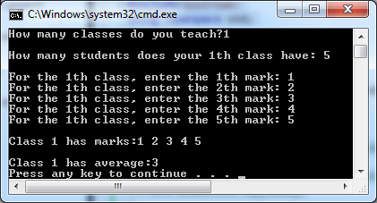
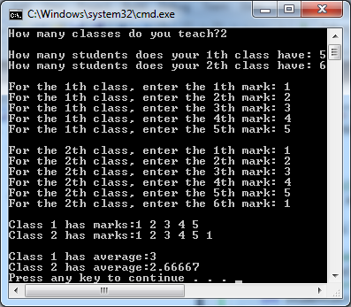

Slide 60
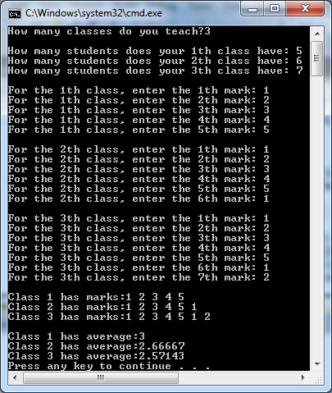

Slide 61

Transverse static three-dimensional array elements
int myArray[2][3][4] = {
{{1, 2, 3, 4}, {5, 6, 7, 8}, {9, 10, 11, 12}},
{{13, 14, 15, 16}, {17, 18, 19, 20}, {21, 22, 23, 24}}
};
We can use loops to transverse array elements:
for(int i=0; i<2; i++)
{
for(int j=0; j<3; j++)
{
//show rows
cout<<"{ ";
for(int k=0; k<4; k++)
{
cout<< myArray[i][j][k]<<" ";
}
cout<<"}, ";
}
//move to next group
cout<<endl;
}

Slide 62

Transverse static three-dimensional array elements
int myArray[2][3][4] = {
{{1, 2, 3, 4}, {5, 6, 7, 8}, {9, 10, 11, 12}},
{{13, 14, 15, 16}, {17, 18, 19, 20}, {21, 22, 23, 24}}
};
We can use loops to transverse array elements:
int sum = 0;
for(int i=0; i<2; i++)
{
for(int j=0; j<3; j++)
{
for(int k=0; k<4; k++)
{
sum += myArray[i][j][k];
}
}
}
cout<<"The sum of elements is: "<<sum<<endl;

Slide 63
Class average
Write a C++ program that helps a teacher finds the average of student marks for years 9X, 10X, 11X, 12X, and for each year he teaches grades from A to C.

Slide 64
#include<iostream>
using namespace std;
int main()
{
//variable declaration
int i,j, k, l;
int groupNum, maxGroupNum=0, classNum, maxStudentNum=0, sum=0;
float average;
// a static three dimensional array with more elements that a teacher can ever imagine to use
int marksArray[10][100][100];
//a static array to save the group numbers
int groupArray[1000];
//a static array to save the student number for each class
int studentsArray[1000];
//get number of groups
cout<<"How many level groups of classes do you teach? ";
cin>>groupNum;

Slide 65
//get number of classes in a group
cout<<endl;
for( i=0; i<groupNum; i++)
{
cout<<"How many classes does your "<<i+1<<"th group have? ";
cin>>groupArray[i];
//save the largest number
if( groupArray[i] >maxGroupNum)
{
maxGroupNum = groupArray[i];
}
}

Slide 66
//get students for each group
cout<<endl;
for( i=0; i<groupNum; i++)
{
for (j = 0; j< maxGroupNum; j++)
{
if ( j < groupArray[i])
{
cout<<"For the "<<i+1<<"th group, how many students does class "<<j+1<<"th have? ";
cin>>studentsArray[i];
//save the largest student number
if(studentsArray[i] >maxStudentNum)
{
maxStudentNum = studentsArray[i];
}
}
}
cout<<endl;
}

Slide 67
//get the marks
for( i = 0; i<groupNum; i++)
{
cout<<"***FOR THE "<<i+1<<"th GROUP: \n";
for(j=0; j<maxGroupNum; j++)
{
if(j <groupArray[i])
{
for ( k = 0; k<maxStudentNum; k++)
{
if(k <studentsArray[j])
{
cout<<"For the "<< j+1 <<"th class, enter the "<<k+1<<"th mark: ";
cin>>marksArray[i][j][k];
}
}
cout<<endl;
}
}
cout<<endl;
}

Slide 68
//show the marks entered
for( i = 0; i<groupNum; i++)
{
cout<<"***FOR THE "<<i+1<<"th GROUP: \n";
for(j=0; j<maxGroupNum; j++)
{
if(j <groupArray[i])
{
cout<<"The "<< j+1 <<"th class, has grades: ";
for ( k = 0; k<maxStudentNum; k++)
{
if(k <studentsArray[j])
{
cout<<marksArray[i][j][k]<<" ";
}
}
}
cout<<endl;
}
cout<<endl;
}

Slide 69
cout<<endl;
cout<<endl;
//get the average for each class
for( i = 0; i<groupNum; i++)
{
cout<<"***FOR THE "<<i+1<<"th GROUP: \n";
for(j=0; j<maxGroupNum; j++)
{
if(j <groupArray[i])
{
cout<<"The "<< j+1 <<"th class, has average: ";
for ( k = 0; k<maxStudentNum; k++)
{
if(k <studentsArray[j])
{
sum += marksArray[i][j][k];
}
}
//show average
average = (float)(sum)/studentsArray[j];
cout<<average<<endl;
//reset sum
sum=0;
}
cout<<endl;
}
cout<<endl;
}
return 0;
}

Slide 70
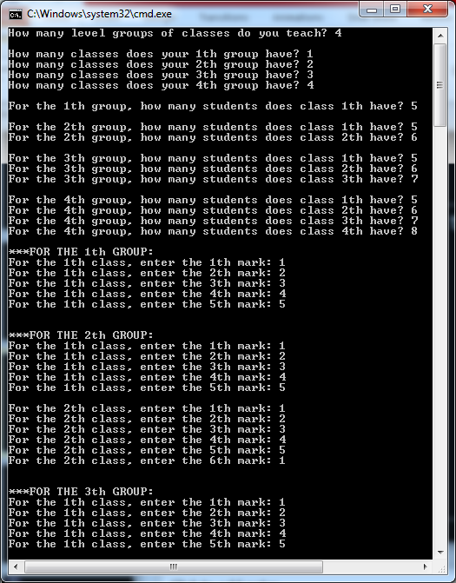
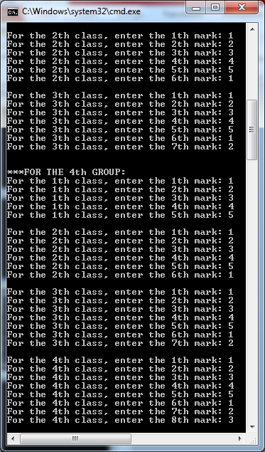

Slide 71
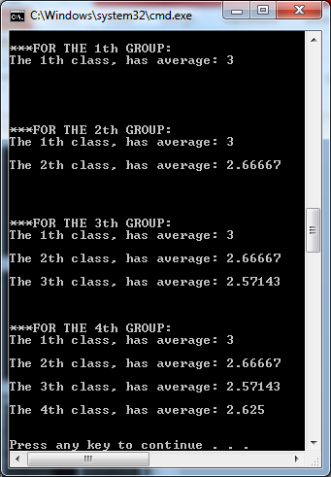
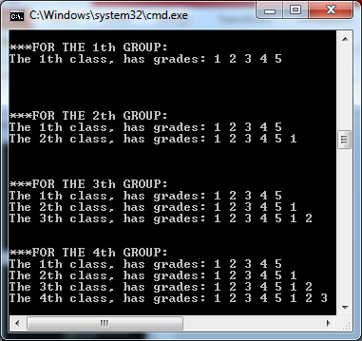

Slide 72
Vectors (Dynamic Arrays)

Slide 73
Vector Class
The vector class is a container class that represents arrays in C++.
The vector is a dynamic data structure, meaning its size can decrease and increase.
#include<vector>
using namespace std;
int main()
{
vector<int> myDynamicArray;
myDynamicArray.resize(5);
}

Slide 74
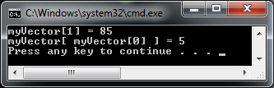
Declaring and initializing a vector
#include<iostream>
#include<vector>
using namespace std;
int main()
{
//declare and resize vector
vector<int> myVector;
myVector.resize(5);
//assign values to each element
myVector[0] = 3;
myVector[1] = 85;
myVector[2] = -7;
myVector[3] = 5;
myVector[4] = 4;
//show values
cout<<"myVector[1] = "<<myVector[1]<<endl;
cout<<"myVector[ myVector[0] ] = "<< myVector[myVector[0] ]<<endl;
return 0;
}

Slide 75
Reading vectors
Write a C++ program that reads N numbers from the user and shows them in the same, and also in reverse order.

Slide 76
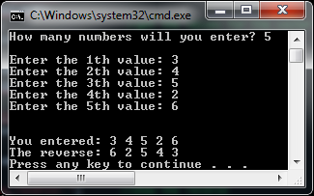
#include<iostream>
#include<vector>
using namespace std;
int main()
{
int n, i;
cout<<"How many numbers will you enter? "; //get user input
cin >>n;
vector<int> myVector; //declare and resize vector of size n
myVector.resize(n);
cout<<endl; //get the values for the vector
for( i=0; i<n; i++)
{
cout<<"Enter the "<<i+1<<"th value: ";
cin>>myVector[i];
}
cout<<"\n\nYou entered: "; //show values entered
for( i=0; i<n; i++)
{
cout<<myVector[i]<<" ";
}
cout<<"\nThe reverse: "; //show the reverse
for( i=n-1; i>=0; i--)
{
cout<<myVector[i]<<" ";
}
cout<<endl;
return 0;
}

Slide 77
Collecting Coins
You are given N coins in a line. The value of each coin can only be 1, 2, 5, 10, 25, or 50.
Write a C++ program that gets the number of coins N, a selection factor K, and the values of coins.
Your program must calculate the sum of coins in the position i*K where i starts from 0 and increases by 1.

Slide 78
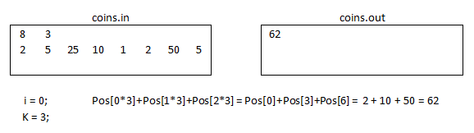
Collecting Coins
You must manually create the file coins.in on the project folder.

Slide 79
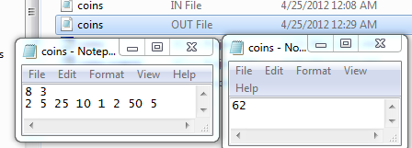
#include<fstream>
#include<vector>
using namespace std;
int main()
{
ifstream fin("coins.in"); //open the input file, create output file
ofstream fout("coins.out");
int n, k, i, result=0; //variable declaration
fin>>n>>k;
vector<int> myCoins; //vector declaration
myCoins.resize(n);
for(i = 0; i<n; i++) //read the n coins
{
fin>>myCoins[i];
}
for(i = 0; i<n; i++) //calculate the sum of coins with step i*k
{
if( i*k < n)
{
result += myCoins[i*k];
}
}
fout<<result; //save result in file
fin.close(); //close both files
fout.close();
return 0;
}

Slide 80
Vector Manipulation
A vector can be assigned to another vector with the assignment operator ( = )
Two vectors can be compared by using the relational operators ( ==, !=, <, <=, >, >= )

Slide 81
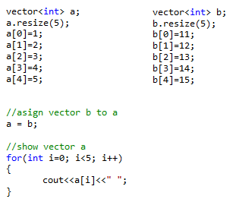

Assigning vectors
A vector can be assigned to another vector with the assignment operator ( = )
Both vectors must have the same type, and also the same size.

Slide 82
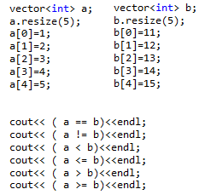
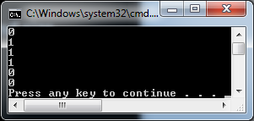
Comparing Vectors
Two vectors can be compared by using the relational operators ( ==, !=, <, <=, >, >= )
Both vectors must have the same type, but they can have different size.
A condition must be true for all element with the same index.

Slide 83
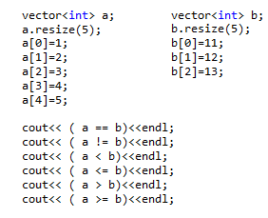
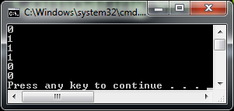
Comparing Vectors
Both vectors must have the same type, but they can have different size.

Slide 84
Vector Methods
The vector class provides some methods for handling vector operations:
Method | Description
size | Returns the number of elements in the vector.
resize | Sets a new size for a vector.
push_back | Adds a new element to the end of the vector.
begin | Returns an iterator to the first element of the vector.
end | Returns an iterator to the last element of the vector.
assign | Erases a vector and copies the specified elements to the empty vector.
reverse | Reverses a minimum length of storage for a vector object.
insert | Inserts an element, or a number of elements into the vector at a specified position.
at | Returns a reference to the item at a specified location in the vector.

Slide 85

myVector.resize(newsize,value);
Specifies a new size for a vector.
vector<int> myVector;
myVector.resize(5);
myVector[0]=1;
myVector[1]=2;
myVector[2]=3;
myVector[3]=4;
myVector[4]=5;
//resize vector and fill empty positions with value
myVector.resize(7,-99);
//show change
for (int i=0; i<7; i++)
{
cout<<myVector[i]<<" ";
}

Slide 86

myVector.size();
Returns the number of elements in the vector.
vector<int> myVector;
myVector.resize(5);
cout<<"Size is: "<<myVector.size()<<endl;
//resize vector
myVector.resize(12);
cout<<"Size is: "<<myVector.size()<<endl;

Slide 87

myVector.empty();
true if the vector is empty; false if the vector is not empty.
vector<int> myVector;
cout<<"Is empty? "<<myVector.empty()<<endl;
myVector.resize(5);
cout<<"Is empty? "<<myVector.empty()<<endl;
//its not empty, what values does it have by default?
for(int i=0; i<myVector.size(); i++)
{
cout<<myVector[i]<<" ";
}

Slide 88

myVector.at(position);
Returns a reference to the element at a specified location in the vector.
vector<int> myVector;
myVector.resize(5);
myVector[0]=1;
myVector[1]=2;
myVector[2]=3;
myVector[3]=4;
myVector[4]=5;
//show vector element
cout<<myVector[3]<<endl;
//assign the vector element with index 3 to a reference variable
int &num1 = myVector.at(3);
//a change in reference will change the vector element also
num1 += 10;
//show the new value
cout<<myVector[3]<<endl;

Slide 89

myVector.front();
Returns a reference to the first element in a vector.
myVector.back();
Returns a reference to the last element of the vector.
vector<int> myVector;
myVector.resize(5);
myVector[0]=1;
myVector[4]=5;
int &num1 = myVector.front();
//if reference changes, so does the vector value
num1 +=10;
cout<<myVector[0]<<endl;
int &num2 = myVector.back();
//if reference changes, so does the vector value
num2 +=20;
cout<<myVector[4]<<endl;

Slide 90
myVector.begin();
Returns a random-access iterator to the first element in the container.
myVector.end();
Returns a random-access iterator that points just beyond the end of the vector.

Slide 91

myVector.erase(where,last);
Removes an element or a range of elements in a vector from specified positions.
vector<int> myVector;
myVector.resize(5);
myVector[0]=1; myVector[1]=2; myVector[2]=3;
myVector[3]=4; myVector[4]=5;
//show vector
for(int i=0; i<myVector.size(); i++)
{
cout<<myVector[i];
}
cout<<endl;
//erase first element
myVector.erase(myVector.begin());
//show vector
for(int i=0; i<myVector.size(); i++)
{
cout<<myVector[i];
}
cout<<endl;

Slide 92

myVector.erase(where,last);
Removes an element or a range of elements in a vector from specified positions.
vector<int> myVector;
myVector.resize(5);
myVector[0]=1; myVector[1]=2; myVector[2]=3;
myVector[3]=4; myVector[4]=5;
//show vector
for(int i=0; i<myVector.size(); i++)
{
cout<<myVector[i];
}
cout<<endl;
//erase last element
myVector.erase(myVector.end()-1);
//show vector
for(int i=0; i<myVector.size(); i++)
{
cout<<myVector[i];
}
cout<<endl;

Slide 93

myVector.erase(where,last);
Removes an element or a range of elements in a vector from specified positions.
vector<int> myVector;
myVector.resize(5);
myVector[0]=1; myVector[1]=2; myVector[2]=3;
myVector[3]=4; myVector[4]=5;
//show vector
for(int i=0; i<myVector.size(); i++)
{
cout<<myVector[i];
}
cout<<endl;
//erase position element
myVector.erase(myVector.begin()+2);
//show vector
for(int i=0; i<myVector.size(); i++)
{
cout<<myVector[i];
}
cout<<endl;

Slide 94

myVector.erase(where,last);
Removes an element or a range of elements in a vector from specified positions.
vector<int> myVector;
myVector.resize(5);
myVector[0]=1; myVector[1]=2; myVector[2]=3;
myVector[3]=4; myVector[4]=5;
//show vector
for(int i=0; i<myVector.size(); i++)
{
cout<<myVector[i];
}
cout<<endl;
//erase from first until third myVector.erase(myVector.begin(),myVector.begin()+3);
//show vector
for(int i=0; i<myVector.size(); i++)
{
cout<<myVector[i];
}
cout<<endl;

Slide 95
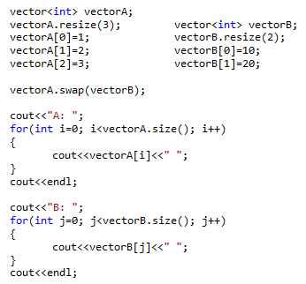

myVector.swap(vector);
Exchanges the elements of two vectors.

Slide 96

myVector.push_back();
Adds an element to the end of the vector.
vector<int> myVector;
//add a new last element
myVector.push_back(1);
//add a new last element
myVector.push_back(2);
//show vector
for(int i=0; i<myVector.size(); i++)
{
cout<<myVector[i]<<" ";
}
cout<<endl;
//add a new last element
myVector.push_back(3);
//show vector
for(int j=0; j<myVector.size(); j++)
{
cout<<myVector[j]<<" ";
}
cout<<endl;

Slide 97

myVector.pop_back();
Deletes the element at the end of the vector.
vector<int> myVector;
myVector.push_back(1); myVector.push_back(2);
myVector.push_back(3); myVector.push_back(4);
myVector.push_back(5);
//delete last element
myVector.pop_back();
//show vector
for(int i=0; i<myVector.size(); i++)
{
cout<<myVector[i]<<" ";
}
cout<<endl;
//delete last element
myVector.pop_back();
myVector.pop_back();
//show vector
for(int j=0; j<myVector.size(); j++)
{
cout<<myVector[j]<<" ";
}
cout<<endl;

Slide 98

myVector.insert(where,value);
Inserts an element or a number of elements or a range of elements into the vector at a specified position.
vector<int> myVector;
myVector.push_back(1);
myVector.push_back(3);
myVector.push_back(5);
//insert at second position number 2
myVector.insert(myVector.begin()+1, 2);
//show vector
for(int i=0; i<myVector.size(); i++)
{
cout<<myVector[i]<<" ";
}
cout<<endl;
//insert at fourth position number 4;
myVector.insert(myVector.begin()+3, 4);
//show vector
for(int i=0; i<myVector.size(); i++)
{
cout<<myVector[i]<<" ";
}
cout<<endl;

Slide 99

myVector.insert(where, count, value);
Inserts an element or a number of elements or a range of elements into the vector at a specified position.
vector<int> myVector;
myVector.push_back(1);
myVector.push_back(5);
//insert from second position, three times number 4
myVector.insert(myVector.begin()+1,3, 4);
//show vector
for(int i=0; i<myVector.size(); i++)
{
cout<<myVector[i]<<" ";
}
cout<<endl;
//insert from second position, two times number 3
myVector.insert(myVector.begin()+1, 2, 3);
//show vector
for(int i=0; i<myVector.size(); i++)
{
cout<<myVector[i]<<" ";
}
cout<<endl;

Slide 100

myVector.insert(where, first, last);
Inserts an element or a number of elements or a range of elements into the vector at a specified position.
vector<int> myVector;
myVector.push_back(1); myVector.push_back(2);
myVector.push_back(3); myVector.push_back(4);
myVector.push_back(5);
//show vector
for(int i=0; i<myVector.size(); i++)
{
cout<<myVector[i]<<" ";
}
cout<<endl;
//insert at third position, range from first until fourth
myVector.insert(myVector.begin()+2 ,myVector.begin(), myVector.begin()+4);
//show vector
for(int i=0; i<myVector.size(); i++)
{
cout<<myVector[i]<<" ";
}
cout<<endl;

Slide 101

myVector.assign(count,value);
Erases a vector and copies the specified elements to the empty vector.
vector<int> vectorA;
//assign to vector A, seven times value 10
vectorA.assign(7, 10);
for(int i=0; i<vectorA.size(); i++)
{
cout<<vectorA[i]<<" ";
}

Slide 102
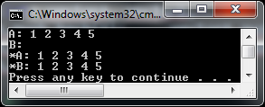
myVector.assign(first,last);
Erases a vector and copies the specified elements to the empty vector.
vector<int> vectorA, vectorB;
vectorA.push_back(1); vectorA.push_back(2);
vectorA.push_back(3); vectorA.push_back(4);
vectorA.push_back(5);
//show A:
//show B:
//assign to vector B, all values of vector A
vectorB.assign(vectorA.begin(), vectorA.end());
//show *A:
//show *B:

Slide 103
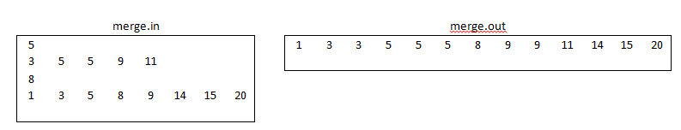
Merging Vectors
Write a C++ program that merges two sorted lists of numbers.
Your program should read the list from a file and print the merged list into another file.

Slide 104
//DESCRIPTION: merge two lists *WORKS ONLY IF LISTS ARE SORTED!*
#include<fstream>
#include<vector>
using namespace std;
int main()
{
//open input file
ifstream fin("merge.in");
ofstream fout("merge.out");
//get first vector
int n, i, j;
fin>>n;
vector<int> A;
A.resize(n);
for(i=0; i<n; i++)
{
fin>>A[i];
}
//get second vector
int k;
fin>>k;
vector<int> B;
B.resize(k);
for(i=0; i<k; i++)
{
fin>>B[i];
}

Slide 105
//declare a third vector to save the result
vector<int> R;
i=0;
j=0;
//compare the elements of both lists
//stop when we reach index of array with less elements
while((i<A.size()) && (j<B.size()))
{
if (A[i] < B[j])
{
//add to the end of result array
R.push_back(A[i]);
//update counter
i++;
}
else
{
//add to the end of result array
R.push_back(B[j]);
//update counter
j++;
}
}

Slide 106
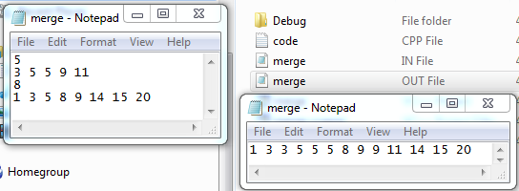
//the elements of the larger list are left out
// check if A is the larger list and if true add them to the end
while(i<A.size())
{
R.push_back(A[i]);
i++;
}
//the elements of the larger list are left out
// check if B is the larger list and if true add them to the end
while(j<B.size())
{
R.push_back(B[j]);
j++;
}
//show resulting vector
for(i=0; i<R.size(); i++)
{
fout<<R[i]<<" ";
}
//close both files
fin.close();
fout.close();
return 0;
}

Slide 107
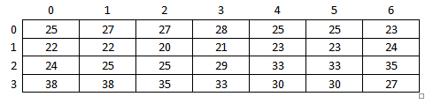
Daily Temperature
Write a C++ program that gets a daily temperature of a month and prints them in tabular format.

Slide 109
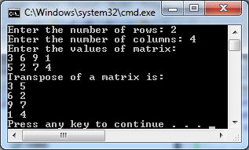
Transpose Matrix
The transpose of a matrix is the reverse orientation of the original matrix, so that the values across the rows become the values down the columns, and the values of the column become the values across the row.

Slide 111
The Biggest Subtotal
You have a NxM matrix filled with numbers between -100 and 100. Find the KxK sub-matrix which has the biggest sum where(K<=N and K<=M)
First line has three integers N, M, K.
Each of the following N lines contain M integers.
Output should display the position of left-upper element in the first line, and sum in the second line.

Slide 112
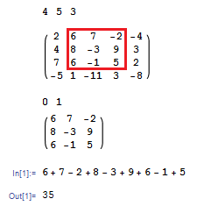
The Biggest Subtotal

Slide 114
Sorted
Write a C++ function that return true if the vector v is sorted in no decreasing order, otherwise it returns false.
bool isSorted(vector<int> v)
{
// sorted
}

Slide 116
Searching Arrays

Slide 117
Searching Arrays
Searching arrays for a particular value is a common activity that any programmer should know how to do.
C++ provides two kind of searching:
Sequential (linear) search
Binary search

Slide 118
Linear Search
Linear Search is best used if the array you are searching is unsorted.
It compares the target value with all the elements of the array one by one starting from the first element until it finds the target value or there are no more elements to compare.

Slide 119
Linear Search
To use linear search you must include the <algorithm> header.
Here the find(start, end, target) method performs linear search.
find() returns a read only iterator addressing the first occurrence in the range.
If the element is not found, then the iterator will address the position one beyond the final element.

Slide 120

//DESCRIPTION: Linear Search
#include<iostream>
#include<vector>
#include<algorithm>
using namespace std;
int main()
{
vector<int> v;
vector<int>::iterator it; //declare a random access iterator for a vector
v.push_back(1); //add elements to vector v
v.push_back(13);
v.push_back(4);
v.push_back(7);
it = find(v.begin(), v.end(), 4); //find "4" in the vector and save its address at iterator
//cout<<it<<endl; // this will show an error
//this will show the actual memory address where 4 is saved
cout<<&it<<endl;
if( it != v.end()) //check if iterator is not beyond vector size
{
//we can show the actual value of the address that iterator points to,
//by using the pointer dereferencing operator (*it)
cout<<"Value "<<(*it)<<" was found at "<<it - v.begin()<<"ith position!\n";
}
else { cout<<"Value not found!\n"; }
return 0;
}

Slide 121
Linear Search
Write your own version of the linear search function. Your function should take a vector and a target as input parameters, and return the position of the target in the vector.
If the target does not exit in the vector, your function should return -1.
int linearSearch(vector<int>, int target)
{
}

Slide 123
Binary Search
Binary search is recommended to find a specific value in a sorted list.
Use the sort(start,end) method to sort a vector.
Use the binary_search(start, end, target) method to perform binary search. It returns true if the value is found, otherwise false.

Slide 124

//DESCRIPTION: Binary Search
#include<iostream>
#include<vector>
#include<algorithm>
using namespace std;
int main()
{
vector<int> v;
v.push_back(1);
v.push_back(13);
v.push_back(4);
v.push_back(7);
//sort this vector
sort(v.begin(), v.end());
//check if value is present
if( binary_search(v.begin(),v.end(), 4))
{
cout<<"The value was found!\n";
}
else
{
cout<<"Not found!\n";
}
return 0;
}

Slide 125
Binary Search
Complete the binary search function so that it returns the position of the target value or -1 if the target is not in the vector.
Binary search begins by comparing the target value to the value in the middle of the vector; because the values are sorted, it is clear that whether the target value would belong before or after that middle value, and the search then continues through the correct half in the same way.

Slide 126
int binarySearch(vector<int>, int target)
{
int first = 0, last = v.size()-1;
while(first <= last)
{
int middle = (________)/2;
if (v[middle] == target)
{ return middle; }
if (target < v[middle])
{ last = middle-1; }
else
{ first = _______; }
}
return ______________;
}

Slide 127
Vectors
Write a C++ function that takes two vectors as parameters and checks if the second vector contains all of the elements of the first vector. If yes returns true, otherwise returns false.
bool test(TIntVec v1, TIntVec v2)
{
//
}
INPUT: v1: 3 6 7 3 8 7
v2: 2 9 4 8 5 6 7 3 1
OUTPUT: YES!

Slide 129
Sorting Arrays

Slide 130
Sorting Arrays
Having sorted data facilitates the processing of information.
C++ provides the sort() method to sort the vectors and other containers.
Sort in ascending order:
sort(v.begin(), v.end());
Sort in descending order:
sort(v.begin(), v.end(), greater<int>());

Slide 131
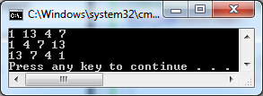
//DESCRIPTION: Sorting arrays
#include<iostream>
#include<vector>
#include<algorithm>
#include<functional> // only for greater<int>()
using namespace std;
int main()
{
vector<int> v;
v.push_back(1); v.push_back(13); v.push_back(4); v.push_back(7);
int i; //show original vector
for(i=0; i< v.size(); i++)
{
cout<<v[i]<<" ";
} cout<<endl;
sort(v.begin(), v.end()); //sort array in ascending order
for(i=0; i< v.size(); i++) //show vector in ascending order
{
cout<<v[i]<<" ";
} cout<<endl;
sort(v.begin(), v.end(), greater<int>()); //sort array in descending order
for(i=0; i< v.size(); i++) //show vector in descending order
{
cout<<v[i]<<" ";
} cout<<endl;
return 0;
}

Slide 132
Reverse a vector
Once you get a vector in ascending order, you may use the reverse() method to get the vector sorted in descending order.
//reverse vector
reverse(v.begin(), v.end());

Slide 133
//DESCRIPTION: Reverse array
#include<iostream>
#include<vector>
#include<algorithm>
using namespace std;
int main()
{
vector<int> v;
v.push_back(1); v.push_back(13); v.push_back(4); v.push_back(7);
int i; //show original vector
for(i=0; i< v.size(); i++)
{
cout<<v[i]<<" ";
} cout<<endl;
sort(v.begin(), v.end()); //sort array in ascending order
for(i=0; i< v.size(); i++) //show vector in ascending order
{
cout<<v[i]<<" ";
} cout<<endl;
reverse(v.begin(), v.end()); //reverse array
for(i=0; i< v.size(); i++) //show vector in descending order
{
cout<<v[i]<<" ";
} cout<<endl;
return 0;
}

Slide 134
Bubble Sort
The bubble sort repeatedly compares adjacent elements of an array.
The first and second elements are compared and swapped if out of order.
This sorting process continues until the last two elements of the array are compared and swapped if out of order.

Slide 135


//DESCRIPTION: BUBBLE SORT
#include <iostream>
#include <ctime>
using namespace std;
int main()
{
clock_t start = clock(); // start the clock
int num[10000]={684637774, -999994442, .. .. .. 797017826}; //an array with 10000 elements
int numLength =10000;
// BUBBLE SORT
int i, j, flag = 1; // set flag to 1 to start first pass
int temp; // holding variable
for(i = 1; (i <= numLength) && flag; i++)
{
flag = 0;
for (j=0; j < (numLength -1); j++)
{
if (num[j+1] > num[j]) // ascending order simply changes to <
{
temp = num[j]; // swap elements
num[j] = num[j+1];
num[j+1] = temp;
flag = 1; // indicates that a swap occurred.
}
}
} // END OF BUBBLE SORT
//show sorted array for( i = 0; i<numLength; i++) { cout<<num[i]<<" "; }
clock_t ends = clock(); //stop the clock
cout <<"\nRunning time in milliseconds : " << (double) (ends - start) << endl;
return 0;
}

Slide 136
Quick Sort
The quicksort is considered to be very efficient, with its "divide and conquer" algorithm.
This sort starts by dividing the original array into two sections (partitions) based upon the value of the first element in the array.
Since our example sorts into descending order, the first section will contain all the elements greater than the first element. The second section will contain elements less than (or equal to) the first element.
This sort uses recursion - the process of "calling itself".

Slide 137
//DESCRIPTION: QUICK SORT
#include <iostream>
#include <ctime>
using namespace std;
// QUICK SORT FUNCTION
void quickSort(int arr[],int left,int right)
{
int i = left, j = right;
int tmp;
int pivot = arr[(left + right) / 2];
/* partition */
while (i <= j) {
while (arr[i] < pivot)
i++;
while (arr[j] > pivot)
j--;
if (i <= j) {
tmp = arr[i];
arr[i] = arr[j];
arr[j] = tmp;
i++;
j--;
}
};
// recursion
if (left < j)
quickSort(arr, left, j);
if (i < right)
quickSort(arr, i, right);
}
int main()
{
// start the clock
clock_t start = clock();

Slide 138


//DESCRIPTION: QUICK SORT
int main()
{
// start the clock
clock_t start = clock();
//an array with 10000 elements
int num[10000]={684637774, -999994442, .. .. .. 797017826};
int numLength =10000;
// CALL QUICK SORT FUNCTION
quickSort(num, 0, numLength-1);
// END OF QUICK SORT
//show sorted array for( int i = 0; i<numLength; i++) { cout<<num[i]<<" ";}
//stop the clock
clock_t ends = clock();
cout <<"\nRunning time in milliseconds : " << (double) (ends - start) << endl;
return 0;
}

Slide 139
String Class

Slide 140
Strings
A character is any symbol that can be read from the keyboard.
char letter = 'A';
A string is a series of characters.
string str("Hello World 1!");
string str = "Hello World 2!";
C++ has a very powerful ( and long ) string class defined in the <string> header file providing methods to manipulate strings.

Slide 141
Reading & Printing Strings
So far we have read strings with cin and printed them with cout, however cin is limited because it reads a one-word string.
A better cin alternative is the method getline() which reads a line of text from the input stream.

Slide 142
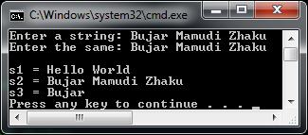
//DESCRIPTION: getline(cin,string) VS. cin
#include<iostream>
#include<string>
using namespace std;
int main()
{
//declare three strings
string s1 = "Hello World", s2, s3;
//read second string
cout<<"Enter a string: ";
getline(cin, s2); //reads a line of text
//read third string
cout<<"Enter the same: ";
cin>>s3; //reads first word only
cout<<"\ns1 = "<<s1<<endl;
cout<<"s2 = "<<s2<<endl;
cout<<"s3 = "<<s3<<endl;
return 0;
}

Slide 143

String delimiter
The getline() function can be used with a delimiter to read the first part of the input stream until the delimiter character.
The following statement reads only the first word of the input text because it stops at empty space.
string str;
cout<<"Enter a string: ";
getline(cin, str, ' '); //read until empty space
cout<<str<<endl;

Slide 144
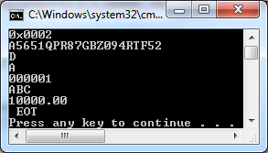
//DESCRIPTION: Separate a string and save the parts in a vector
#include<iostream>
#include<string>
#include<sstream> //convert string to a stream of characters
#include<vector>
using namespace std;
int main()
{
string str = "0x0002,A5651QPR87GBZ094RTF52,D,A,000001,ABC ,10000.00 , EOT";
string word;
vector<string> stringVector;
// convert string as a stream of characters
stringstream stream(str);
//separate characters with delimiter ","
while( getline(stream, word, ',') )
{
//cout << word << "\n";
stringVector.push_back(word);
}
//show saved vector
for(int i=0; i<stringVector.size(); i++)
{
cout<<stringVector[i]<<"\n";
}
return 0;
}

Slide 145

//DESCRIPTION: A very practical problem. Save string to vector, convert to int then find sum
#include<iostream>
#include<string>
#include<sstream> //convert string to a stream of characters
#include<vector>
using namespace std;
int main()
{
string str = "1 2 3 4 5 6 7 8 9 10";
string word;
vector<string> stringVector;
// convert string as a stream of characters
stringstream stream(str);
//separate characters with delimiter " "
while( getline(stream, word, ' ') )
{
//cout << word << "\n";
stringVector.push_back(word);
}
//show saved string vector
int sum = 0;
for(int i=0; i<stringVector.size(); i++)
{
cout<<stringVector[i]<<" ";
//convert each string element to integer
sum += atoi(stringVector[i].c_str());
}
cout<<"\nSum = "<<sum<<endl;
return 0;
}

Slide 146

//DESCRIPTION: A very practical problem, find average of a string
#include<iostream>
#include<string>
#include<sstream> //convert string to a stream of characters
#include<vector>
using namespace std;
int main()
{
string str = "1 2 3 4 5 6 7 8 9 10";
string word;
vector<string> stringVector;
// convert string as a stream of characters
stringstream stream(str);
//separate characters with delimiter " "
while( getline(stream, word, ' ') )
{
//cout << word << "\n";
stringVector.push_back(word);
}
//show saved string vector
float sum = 0;
for(int i=0; i<stringVector.size(); i++)
{
cout<<stringVector[i]<<" ";
//convert each string element to float
sum += atof(stringVector[i].c_str());
}
cout<<"\nAverage = "<<sum/stringVector.size()<<endl;
return 0;
}

Slide 147
String Manipulation
Since strings represent arrays of characters, most of the vector class methods work with strings also.
Assignment (=) and relational operators (==, !=, <, <=, >, >=) are used to assign and compare two strings.

Slide 148
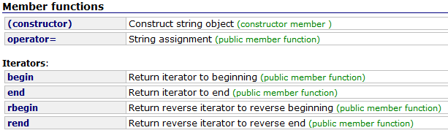
String Methods
The string class has a vast number of useful methods:
The full list can be found at this webpage: http://msdn.microsoft.com/en-us/library/7wtc81z6.aspx

Slide 149
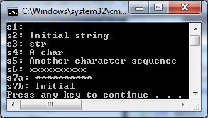
String constructor ()
Constructs a standard string object and initializes its content.
string s0 ("Initial string");
string s1;
string s2 (s0);
string s3 (s0, 8, 3);
string s4 ("A character sequence", 6);
string s5 ("Another character sequence");
string s6 (10, 'x');
string s7a (10, 42);
string s7b (s0.begin(), s0.begin()+7);
cout << "s1: " << s1 << "\ns2: " << s2 << "\ns3: " << s3;
cout << "\ns4: " << s4 << "\ns5: " << s5 << "\ns6: " << s6;
cout << "\ns7a: " << s7a << "\ns7b: " << s7b << endl;

Slide 150

String assignment =
Sets a copy of the argument as the new content for the string object.
string str1, str2, str3;
str1 = "Test string: "; // c-string
str2 = 'x'; // single character
str3 = str1 + str2; // string
cout << str3 << endl;

Slide 151
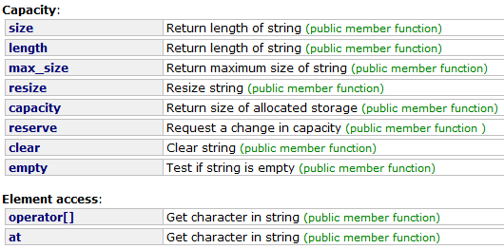
String Methods
The full list can be found at this webpage: http://msdn.microsoft.com/en-us/library/7wtc81z6.aspx

Slide 152

String length()
Returns a count of the number of characters in the string.
string str ("Test string");
cout << "The length of str is " << str.length() << " characters.\n";

Slide 153
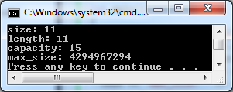
String max_size()
Returns the maximum number of characters that the string object can hold.
string str ("Test string");
cout << "size: " << str.size() << "\n";
cout << "length: " << str.length() << "\n";
cout << "capacity: " << str.capacity() << "\n";
cout << "max_size: " << str.max_size() << "\n";

Slide 154
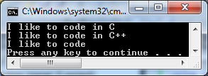
String resize()
Resizes the string content to n characters.
size_t sz;
string str ("I like to code in C");
cout << str << endl;
sz=str.size();
str.resize (sz+2,'+');
cout << str << endl;
str.resize (14);
cout << str << endl;

Slide 155

String operator[]
Returns a reference the character at position in the string.
string str ("Test string");
int i;
for (i=0; i < str.length(); i++)
{
cout << str[i]<<“ “;
}

Slide 156
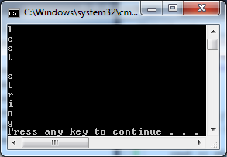
String at()
Returns the character at position in the string.
string str ("Test string");
for (size_t i=0; i < str.length(); i++)
{
cout << str.at(i)<<endl;
}

Slide 157
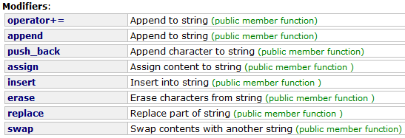
String Methods
The full list can be found at this webpage: http://msdn.microsoft.com/en-us/library/7wtc81z6.aspx

Slide 158

String operator +=
Appends a copy of the argument to the string.
string name ("John");
string family ("Smith");
name += " K. "; // c-string
name += family; // string
name += '\n'; // character
cout << name;

Slide 159

String append()
The current string content is extended by adding an additional appending string at its end.
string str;
string str2="Writing ";
string str3="print 10 and then 5 more";
str.append(str2); // "Writing "
str.append(str3,6,3); // "10 "
str.append("dots are cool",5); // "dots "
str.append("here: "); // "here: "
str.append(10,'.'); // ".........."
str.append(str3.begin()+8,str3.end()); // " and then 5 more"
str.append<int>(5,0x2E); // "....."
cout << str << endl;

Slide 160
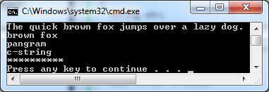
String assign()
Assigns new content to the string replacing its current content.
string str;
string base="The quick brown fox jumps over a lazy dog.";
str.assign(base);
cout << str << endl;
str.assign(base,10,9);
cout << str << endl; // "brown fox"
str.assign("pangrams are cool",7);
cout << str << endl; // "pangram"
str.assign("c-string");
cout << str << endl; // "c-string"
str.assign(10,'*');
cout << str << endl; // "**********"

Slide 161

String insert()
The current string content is extended by inserting some additional content at a specific location within the string content.
string str="to be question";
string str2="the ";
string str3="or not to be";
str.insert(6,str2); // to be (the )question
str.insert(6,str3,3,4); // to be (not )the question
str.insert(10,"that is cool",8); // to be not (that is )the question
str.insert(10,"to be "); // to be not (to be )that is the question
str.insert(15,1,':'); // to be not to be(:) that is the question
str.insert (str.end(),3,'.'); // to be not to be: that is the question(...)

Slide 162
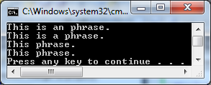
String erase()
Erases a part of the string content, shortening the length of the string.
string str ("This is an example phrase.");
string::iterator it;
str.erase (10,8);
cout << str << endl; // "This is an phrase."
it=str.begin()+9;
str.erase (it);
cout << str << endl; // "This is a phrase."
str.erase (str.begin()+5, str.end()-7);
cout << str << endl; // "This phrase."
cout<<str<<endl;

Slide 163

String replace()
Replaces a section of the current string by some other content determined by the arguments passed.
string base="this is a test string.";
string str2="n example";
string str3="sample phrase";
string str4="useful.";
// Using positions: 0123456789*123456789*12345
string str=base; // "this is a test string."
str.replace(9,5,str2); // "this is an example string."
str.replace(19,6,str3,7,6); // "this is an example phrase."
str.replace(8,10,"just all",6); // "this is just a phrase."
str.replace(8,6,"a short"); // "this is a short phrase."
str.replace(22,1,3,'!'); // "this is a short phrase!!!"
// Using iterators: 0123456789*123456789*
string::iterator it = str.begin(); // ^
str.replace(it,str.end()-3,str3); // "sample phrase!!!"
str.replace(it,it+6,"replace it",7); // "replace phrase!!!"
it+=8; // ^
str.replace(it,it+6,"is cool"); // "replace is cool!!!"
str.replace(it+4,str.end()-4,4,'o'); // "replace is cooool!!!"
it+=3; // ^
str.replace(it,str.end(),str4.begin(),str4.end());
// "replace is useful."
cout << str << endl;

Slide 164

String swap()
Swaps the contents of the string with those of another string object.
string buyer ("money");
string seller ("goods");
cout << "Before swap, buyer has " << buyer;
cout << " and seller has " << seller << endl;
seller.swap (buyer);
cout << " After swap, buyer has " << buyer;
cout << " and seller has " << seller << endl;

Slide 165
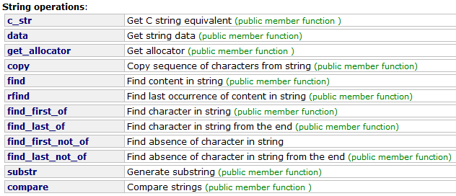
String Methods
The full list can be found at this webpage: http://msdn.microsoft.com/en-us/library/7wtc81z6.aspx

Slide 166
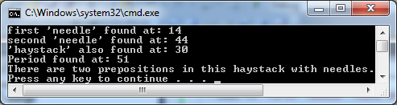
String find()
Searches the string for the content specified, and returns the position of the first occurrence in the string.
string str ("There are two needles in this haystack with needles.");
string str2 ("needle");
size_t found;
found=str.find(str2);
if (found!=string::npos)
cout << "first 'needle' found at: " << int(found) << endl;
found=str.find("needles are small",found+1,6);
if (found!=string::npos)
cout << "second 'needle' found at: " << int(found) << endl;
found=str.find("haystack");
if (found!=string::npos)
cout << "'haystack' also found at: " << int(found) << endl;
found=str.find('.');
if (found!=string::npos)
cout << "Period found at: " << int(found) << endl;
str.replace(str.find(str2),str2.length(),"preposition");
cout << str << endl;

Slide 167

String substr()
Returns a string object with its contents initialized to a substring of the current object.
string str="We think in generalities, but we live in details.";
string str2, str3;
size_t pos;
str2 = str.substr (12,12); // "generalities"
pos = str.find("live"); // position of "live" in str
str3 = str.substr (pos); // get from "live" to the end
cout << str2 << ' ' << str3 << endl;

Slide 168
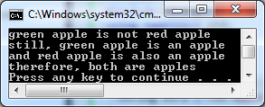
String compare()
Compares the content of this object (or a substring of it, known as compared (sub)string) to the content of a comparing string, which is formed according to the arguments passed.
string str1 ("green apple");
string str2 ("red apple");
if (str1.compare(str2) != 0)
cout << str1 << " is not " << str2 << "\n";
if (str1.compare(6,5,"apple") == 0)
cout << "still, " << str1 << " is an apple\n";
if (str2.compare(str2.size()-5,5,"apple") == 0)
cout << "and " << str2 << " is also an apple\n";
if (str1.compare(6,5,str2,4,5) == 0)
cout << "therefore, both are apples\n";

Slide 169
ALAN FARMER
Write a C++ program that asks Alan for is name, shows his name in reverse, with whitespaces, and also find the first occurrence of the substring “arm”.

Slide 171

Palindromes
A palindrome is a word that reads the same from both sides. Example: MADAM
Write a C++ program that reads words from a text file and decides weather they are palindromes or not.

Slide 173

Student Names
Write a C++ program that reads the names of the students in the classroom and then sorts the names in alphabetical order.

Slide 175
Measuring run time

Slide 176
Measuring run time
As a programmer, we usually want to measure the speed of our program in time (seconds).
C/C++ provides a useful function in timing.
We can use the function
clock_t clock(void);

Slide 177
Measuring run time
We must include either the <ctime> or the <time.h> library.
The idea is simple:
Get the starting and the ending CPU clock time then divide by constant CLOCKS_PER_SEC.

Slide 178
Measuring run time
#include <iostream>
#include <ctime>
using namespace std;
int main()
{
clock_t start = clock(); //start clock
// do something that takes a lot of time
//
clock_t ends = clock(); //end clock
cout << "Running Time : " << (double) (ends - start) / CLOCKS_PER_SEC << endl; //show time in seconds
return 0;
}

Slide 179
//DESCRIPTION: Regional Competition - "PLATA" problem
#include <iostream>
#include <ctime>
using namespace std;
int main()
{
int a, b, c ,d;
int x;
cin >> a >> b >> c;
// its a good idea to start the clock after you have read all the input!
clock_t start = clock(); //start clock
// do something that takes a lot of time
if (((1 <= a) && (a <= 5000)) && ((1 <= b) && (b <= 5000)) && ((1 <= c) && (c <= 5000)))
{
if ((c %b == 0) && (b %a == 0))
{
x = b / a;
d = c * x;
cout<<d<<endl;
}
else

Slide 180


//DESCRIPTION: Regional Competition - "PLATA" problem
else
{
x = b - a;
d = c + x;
cout<<d<<endl;
}
}
else
{
cout<<endl;
}
// stop doing something that takes a lot of time
clock_t ends = clock(); //end clock
//show time in seconds
cout << "Running Time : " << (double) (ends - start) / CLOCKS_PER_SEC << endl;
return 0;
}

Slide 181
Measuring run time
During the competition, after you have solved a problem correctly, you should check if the run time of your program is within the given limit (example less then 1 second).
If your program has a good run time (it respects the limit), comment or delete the extra code for run time, and then submit your solution.

Slide 182
Measuring run time
If your program has a bad run time (it takes more time than the limit), don’t panic.
You must find a way to optimize your code:
things that take a lot of time are usually loops, or algorithms that manipulate arrays.

Slide 183
Optimizing code
You must find a way to optimize your code:
It’s a good idea to save a copy of the code that you already have ( the code that works)
Modify the loop counters ( usually we lower them by some factor), so that it takes less time.
Choose algorithms that take the least time
(example, to sort arrays “Bubble Sort O(n²)” is slower than “Quick Sort O(log n)” )

Slide 184
Bubble Sort
The bubble sort repeatedly compares adjacent elements of an array.
The first and second elements are compared and swapped if out of order.
This sorting process continues until the last two elements of the array are compared and swapped if out of order.

Slide 185
//DESCRIPTION: BUBBLE SORT
#include <iostream>
#include <ctime>
using namespace std;
int main()
{
clock_t start = clock(); // start the clock
int num[10000]={684637774, -999994442, .. .. .. 797017826}; //an array with 10000 elements
int numLength =10000;
// BUBBLE SORT
int i, j, flag = 1; // set flag to 1 to start first pass
int temp; // holding variable
for(i = 1; (i <= numLength) && flag; i++)
{
flag = 0;
for (j=0; j < (numLength -1); j++)
{
if (num[j+1] > num[j]) // ascending order simply changes to <
{
temp = num[j]; // swap elements
num[j] = num[j+1];
num[j+1] = temp;
flag = 1; // indicates that a swap occurred.
}
}
} // END OF BUBBLE SORT
//show sorted array for( i = 0; i<numLength; i++) { cout<<num[i]<<" "; }
clock_t ends = clock(); //stop the clock
cout <<"\nRunning time in milliseconds : " << (double) (ends - start) << endl;
return 0;
}

Slide 186
Quick Sort
The quicksort is considered to be very efficient, with its "divide and conquer" algorithm.
This sort starts by dividing the original array into two sections (partitions) based upon the value of the first element in the array.
Since our example sorts into descending order, the first section will contain all the elements greater than the first element. The second section will contain elements less than (or equal to) the first element.
This sort uses recursion - the process of "calling itself".

Slide 187
//DESCRIPTION: QUICK SORT
#include <iostream>
#include <ctime>
using namespace std;
// QUICK SORT FUNCTION
void quickSort(int arr[],int left,int right)
{
int i = left, j = right;
int tmp;
int pivot = arr[(left + right) / 2];
/* partition */
while (i <= j) {
while (arr[i] < pivot)
i++;
while (arr[j] > pivot)
j--;
if (i <= j) {
tmp = arr[i];
arr[i] = arr[j];
arr[j] = tmp;
i++;
j--;
}
};
// recursion
if (left < j)
quickSort(arr, left, j);
if (i < right)
quickSort(arr, i, right);
}
int main()
{
// start the clock
clock_t start = clock();

Slide 188
//DESCRIPTION: QUICK SORT
int main()
{
// start the clock
clock_t start = clock();
//an array with 10000 elements
int num[10000]={684637774, -999994442, .. .. .. 797017826};
int numLength =10000;
// CALL QUICK SORT FUNCTION
quickSort(num, 0, numLength-1);
// END OF QUICK SORT
//show sorted array for( int i = 0; i<numLength; i++) { cout<<num[i]<<" ";}
//stop the clock
clock_t ends = clock();
cout <<"\nRunning time in milliseconds : " << (double) (ends - start) << endl;
return 0;
}

Slide 189
Sort with loops
It is possible to sort an array with two for loops, and swap the values. This algorithms is too slow.
At the regional competition for the “Komisija” problem you had to sort the values from the greatest to the smallest.
Even if the program was correct, it takes too much time to execute, so the wrong algorithm took away 100 points.

Slide 190


//DESCRIPTION: Regional Competition - "Komisija" Problem
#include <iostream>
#include <ctime>
using namespace std;
int main()
{
clock_t start = clock(); // start the clock
//an array with 10000 elements
int num[10000]={684637774, -999994442, .. .. .. 797017826};
int numLength =10000;
// LOOP SORT - TERRIBLY SLOW!
for (int i = 1; i < numLength; i++)
{
for (int j = 1; j < numLength; j++)
{
if (num[j-1] < num[j])
{
swap(num[j], num[j-1]);
}
}
} // LOOP SORT
// show sorted array for( int k = 0; k<numLength; k++) { cout<<num[k]<<"\n"; }
clock_t ends = clock(); //stop the clock
cout <<"\nRunning time in milliseconds : " << (double) (ends - start) << endl;
return 0;
}

Slide 191
Optimizing code
You should learn how to implement the QuickSort algorithm. It will save you time!
Maybe save a copy of it somewhere in the cloud(PASTEBIN or some other website) and then at the time of the competition access it if you need it.
In any case, you should know how to use it!

Slide 192
Programming with C++
?
?
?
?
?
Questions?
?
?
?
?
?
© 2012 Bujar Mamudi

